Slide 1
PDP analyses

Slide 2
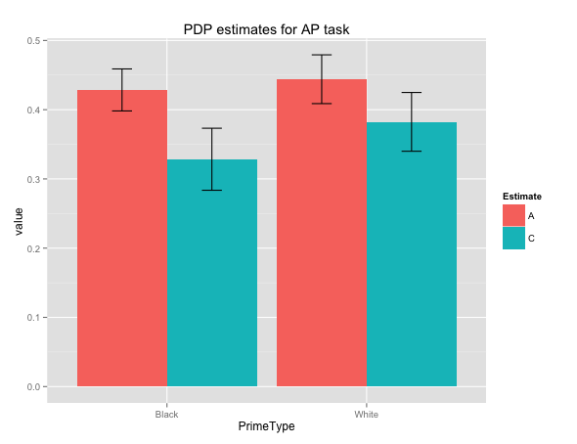
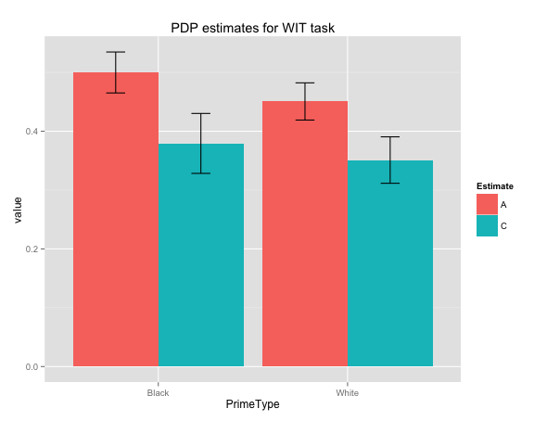
BAD SUBJECTS EXCLUDED (just for relevant task)
AP
WIT
p < .001
p = .02
p = .056
Main effect of Estimate ( p = .005)
White C > Black C (p < .001)
Main effect of Estimate ( p < .001)
Black A > White A (p = .02)
Black C > White C (p = .056)
Notes:
3 way interaction (Prime*Estimate*Task) is not significant
Error: Subject
Df Sum Sq Mean Sq F value Pr(>F)
Residuals 89 7.106 0.07985
Error: Subject:PrimeType
Df Sum Sq Mean Sq F value Pr(>F)
PrimeType 1 0.0007 0.000655 0.042 0.838
Residuals 89 1.3854 0.015567
Error: Subject:Estimate
Df Sum Sq Mean Sq F value Pr(>F)
Estimate 1 1.481 1.4811 15.25 0.000183 ***
Residuals 89 8.641 0.0971
---
Signif. codes: 0 ‘***’ 0.001 ‘**’ 0.01 ‘*’ 0.05 ‘.’ 0.1 ‘ ’ 1
Error: Subject:Task
Df Sum Sq Mean Sq F value Pr(>F)
Task 1 0.0695 0.06953 3.57 0.0621 .
Residuals 89 1.7335 0.01948
---
Signif. codes: 0 ‘***’ 0.001 ‘**’ 0.01 ‘*’ 0.05 ‘.’ 0.1 ‘ ’ 1
Error: Subject:PrimeType:Estimate
Df Sum Sq Mean Sq F value Pr(>F)
PrimeType:Estimate 1 0.0449 0.04491 3.004 0.0865 .
Residuals 89 1.3308 0.01495
---
Signif. codes: 0 ‘***’ 0.001 ‘**’ 0.01 ‘*’ 0.05 ‘.’ 0.1 ‘ ’ 1
Error: Subject:PrimeType:Task
Df Sum Sq Mean Sq F value Pr(>F)
PrimeType:Task 1 0.2401 0.24007 15.05 2e-04 ***
Residuals 89 1.4192 0.01595
---
Signif. codes: 0 ‘***’ 0.001 ‘**’ 0.01 ‘*’ 0.05 ‘.’ 0.1 ‘ ’ 1
Error: Subject:Estimate:Task
Df Sum Sq Mean Sq F value Pr(>F)
Estimate:Task 1 0.0406 0.04063 1.332 0.252
Residuals 89 2.7151 0.03051
Error: Subject:PrimeType:Estimate:Task
Df Sum Sq Mean Sq F value Pr(>F)
PrimeType:Estimate:Task 1 0.0039 0.003948 0.293 0.589
Residuals 89 1.1981 0.013461

Slide 3
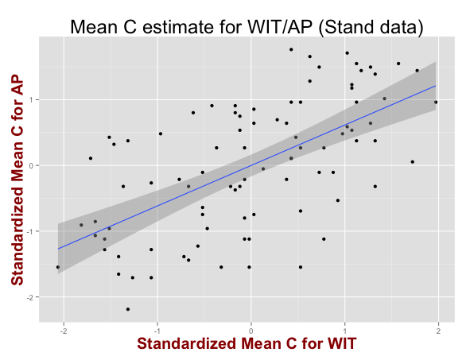
BAD SUBJECTS EXCLUDED (for both tasks)
Correlation of Mean C between tasks (standardized data)
Coefficients:
Estimate Std. Error t value Pr(>|t|)
(Intercept) 1.854e-16 8.353e-02 0.000 1
WIT_MeanC 6.157e-01 8.400e-02 7.329 1.06e-10 ***
Residual standard error: 0.7925 on 88 degrees of freedom
Multiple R-squared: 0.379, Adjusted R-squared: 0.372
F-statistic: 53.72 on 1 and 88 DF, p-value: 1.062e-10

Slide 4
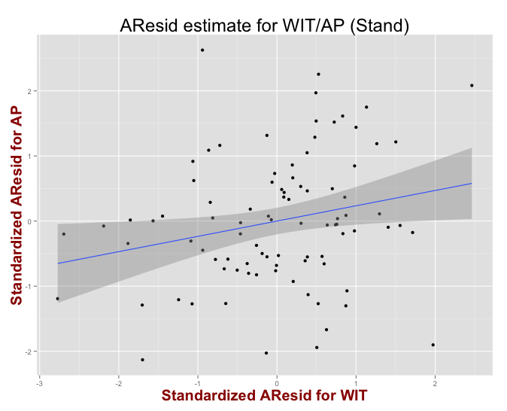
BAD SUBJECTS EXCLUDED (for both tasks)
Correlation of AResid between tasks (standardized data)
Coefficients:
Estimate Std. Error t value Pr(>|t|)
(Intercept) 5.498e-18 1.030e-01 0.000 1.0000
AP_AResid 2.349e-01 1.036e-01 2.267 0.0258 *
Residual standard error: 0.9775 on 88 degrees of freedom
Multiple R-squared: 0.05519, Adjusted R-squared: 0.04445
F-statistic: 5.14 on 1 and 88 DF, p-value: 0.02583

Slide 5
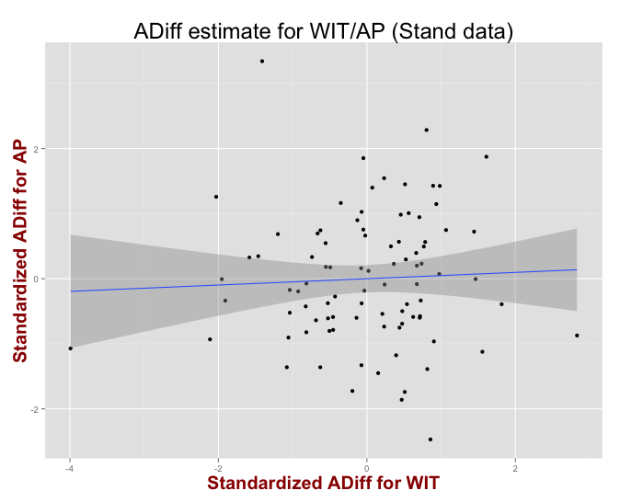
BAD SUBJECTS EXCLUDED (for both tasks)
Correlation of ADiff between tasks (standardized data)
Coefficients:
Estimate Std. Error t value Pr(>|t|)
(Intercept) 3.998e-17 1.059e-01 0.000 1.000
AP_ADiff 4.862e-02 1.065e-01 0.457 0.649
Residual standard error: 1.004 on 88 degrees of freedom
Multiple R-squared: 0.002364, Adjusted R-squared: -0.008973
F-statistic: 0.2085 on 1 and 88 DF, p-value: 0.649

Slide 6
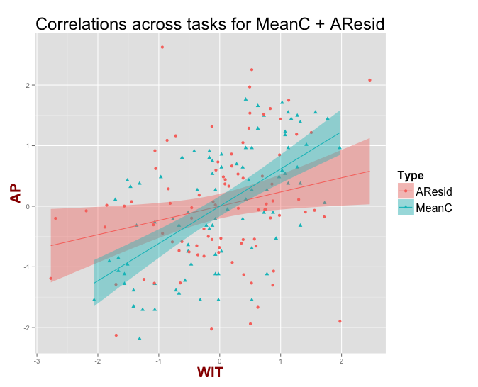
BAD SUBJECTS EXCLUDED (for both tasks)
Comparison of AResid corr. and MeanC corr. simple slopes (standardized data)
Coefficients:
Estimate Std. Error t value Pr(>|t|)
(Intercept) -7.521e-17 9.380e-02 0.000 1.00000
AP 2.349e-01 9.432e-02 2.491 0.01368 *
TypeMeanC 1.072e-16 1.326e-01 0.000 1.00000
AP:TypeMeanC 3.807e-01 1.334e-01 2.854 0.00483 **
Residual standard error: 0.8898 on 176 degrees of freedom
Multiple R-squared: 0.2171, Adjusted R-squared: 0.2038
F-statistic: 16.27 on 3 and 176 DF, p-value: 2.233e-09
Notes:
Same regardless of IV/DV switch because data is standardized

Slide 7
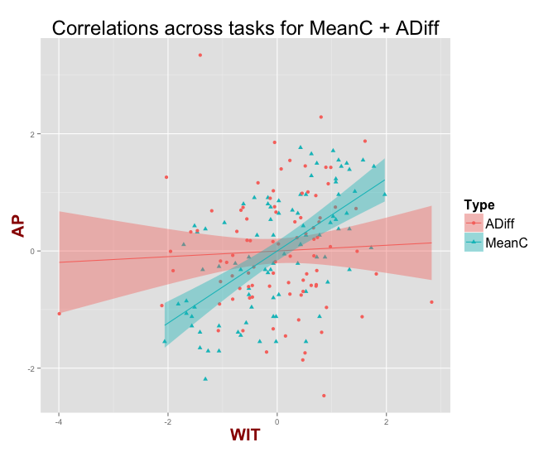
BAD SUBJECTS EXCLUDED (for both tasks)
Comparison of ADiff corr. and MeanC corr. simple slopes (standardized data)
Coefficients:
Estimate Std. Error t value Pr(>|t|)
(Intercept) -5.089e-17 9.536e-02 0.000 1.000
AP 4.862e-02 9.590e-02 0.507 0.613
TypeMeanC 8.548e-17 1.349e-01 0.000 1.000
AP:TypeMeanC 5.670e-01 1.356e-01 4.181 4.57e-05 ***
Residual standard error: 0.9047 on 176 degrees of freedom
Multiple R-squared: 0.1907, Adjusted R-squared: 0.1769
F-statistic: 13.82 on 3 and 176 DF, p-value: 3.892e-08
Notes:
Same regardless of IV/DV switch because data is standardized

Slide 9
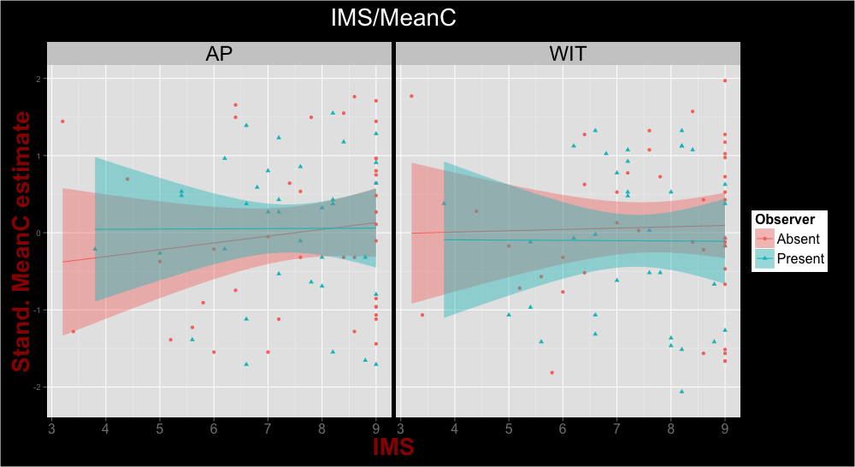
BAD SUBJECTS EXCLUDED (for both tasks) + missing IMS/EMS subs
IMS*Observer interaction predicting MeanC (standardized estimate)
No significant interactions, none of the simple slopes are significant

Slide 10
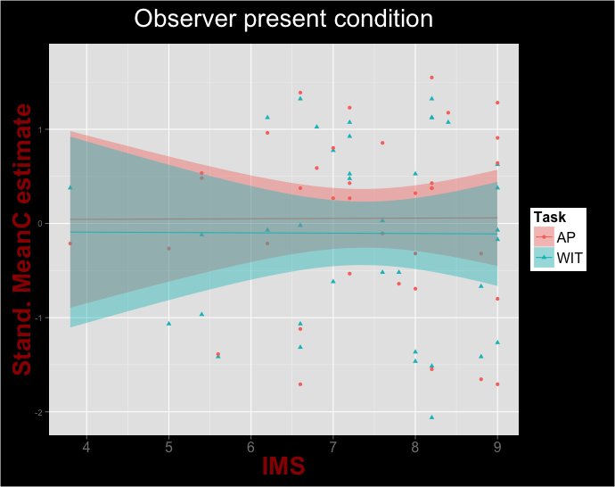
BAD SUBJECTS EXCLUDED (for both tasks) + missing IMS/EMS subs
IMS predicting MeanC (standardized estimate) just in observer present
Coefficients:
Estimate Std. Error t value Pr(>|t|)
(Intercept) 0.031698 0.950828 0.033 0.974
IMS 0.003107 0.127218 0.024 0.981
TaskWIT -0.108446 1.344675 -0.081 0.936
IMS:TaskWIT -0.006864 0.179914 -0.038 0.970
Residual standard error: 0.9725 on 70 degrees of freedom
(16 observations deleted due to missingness)
Multiple R-squared: 0.007036, Adjusted R-squared: -0.03552
F-statistic: 0.1653 on 3 and 70 DF, p-value: 0.9194

Slide 11
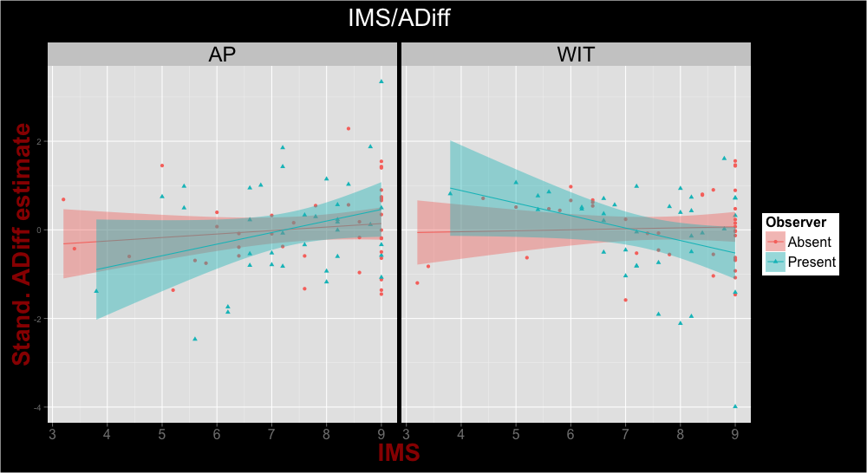
BAD SUBJECTS EXCLUDED (for both tasks) + missing IMS/EMS subs
IMS*Observer interaction predicting ADiff (standardized estimate)
AP Coefficients:
Estimate Std. Error t value Pr(>|t|)
(Intercept) -0.56689 0.72850 -0.778 0.439
IMS 0.07876 0.09378 0.840 0.404
ObserverPresent -1.32249 1.22368 -1.081 0.283
IMS:ObserverPresent 0.18231 0.16156 1.128 0.263
Residual standard error: 1.006 on 74 degrees of freedom
(12 observations deleted due to missingness)
Multiple R-squared: 0.05905, Adjusted R-squared: 0.0209
F-statistic: 1.548 on 3 and 74 DF, p-value: 0.2093
WIT Coefficients:
Estimate Std. Error t value Pr(>|t|)
(Intercept) -0.12990 0.68636 -0.189 0.8504
IMS 0.02189 0.08836 0.248 0.8050
ObserverPresent 2.14422 1.15289 1.860 0.0669 .
IMS:ObserverPresent -0.30382 0.15221 -1.996 0.0496 *
Residual standard error: 0.9475 on 74 degrees of freedom
(12 observations deleted due to missingness)
Multiple R-squared: 0.06857, Adjusted R-squared: 0.03081
F-statistic: 1.816 on 3 and 74 DF, p-value: 0.1516

Slide 12
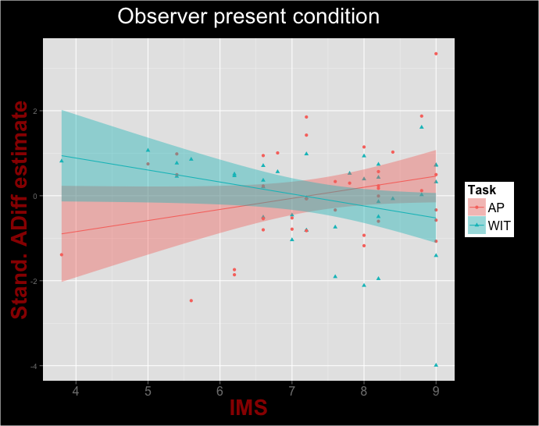
BAD SUBJECTS EXCLUDED (for both tasks) + missing IMS/EMS subs
IMS predicting ADiff (standardized estimate) just in observer present
Coefficients:
Estimate Std. Error t value Pr(>|t|)
(Intercept) -1.8894 1.0754 -1.757 0.08331 .
IMS 0.2611 0.1439 1.814 0.07390 .
TaskWIT 3.9037 1.5209 2.567 0.01241 *
IMS:TaskWIT -0.5430 0.2035 -2.668 0.00946 **
Residual standard error: 1.1 on 70 degrees of freedom
(16 observations deleted due to missingness)
Multiple R-squared: 0.09414, Adjusted R-squared: 0.05532
F-statistic: 2.425 on 3 and 70 DF, p-value: 0.07286

Slide 13
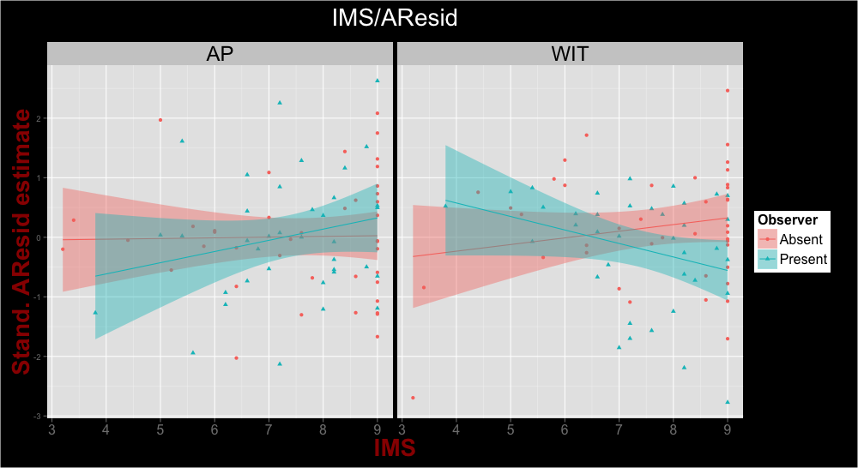
BAD SUBJECTS EXCLUDED (for both tasks) + missing IMS/EMS subs
IMS*Observer interaction predicting AResid (standardized estimate)
AP Coefficients:
Estimate Std. Error t value Pr(>|t|)
(Intercept) -0.07890 0.73873 -0.107 0.915
IMS 0.01164 0.09510 0.122 0.903
ObserverPresent -1.28847 1.24086 -1.038 0.302
IMS:ObserverPresent 0.17641 0.16382 1.077 0.285
Residual standard error: 1.02 on 74 degrees of freedom
(12 observations deleted due to missingness)
Multiple R-squared: 0.02636, Adjusted R-squared: -0.01311
F-statistic: 0.6679 on 3 and 74 DF, p-value: 0.5744
WIT Coefficients:
Estimate Std. Error t value Pr(>|t|)
(Intercept) -0.68015 0.68953 -0.986 0.3272
IMS 0.11166 0.08877 1.258 0.2124
ObserverPresent 2.16217 1.15823 1.867 0.0659 .
IMS:ObserverPresent -0.33824 0.15291 -2.212 0.0301 *
Residual standard error: 0.9519 on 74 degrees of freedom
(12 observations deleted due to missingness)
Multiple R-squared: 0.09298, Adjusted R-squared: 0.0562
F-statistic: 2.528 on 3 and 74 DF, p-value: 0.06379

Slide 14
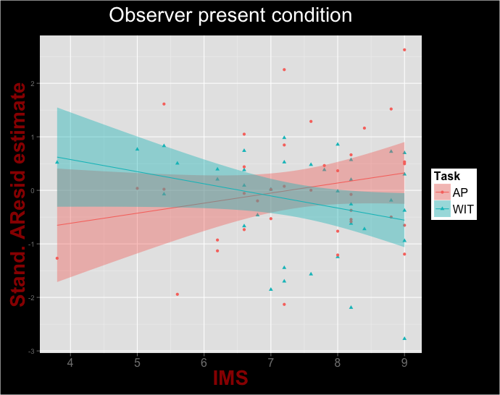
BAD SUBJECTS EXCLUDED (for both tasks) + missing IMS/EMS subs
IMS predicting AResid (standardized estimate) just in observer present
Coefficients:
Estimate Std. Error t value Pr(>|t|)
(Intercept) -1.3674 0.9695 -1.410 0.1628
IMS 0.1881 0.1297 1.450 0.1516
TaskWIT 2.8494 1.3710 2.078 0.0413 *
IMS:TaskWIT -0.4146 0.1834 -2.260 0.0269 *
Residual standard error: 0.9916 on 70 degrees of freedom
(16 observations deleted due to missingness)
Multiple R-squared: 0.0783, Adjusted R-squared: 0.0388
F-statistic: 1.982 on 3 and 70 DF, p-value: 0.1245

Slide 15
Performance Bias is DV
Performance bias =
P(errors|incongruent) – P(errors|congruent)
In ANOVAanalyses.R

Slide 16
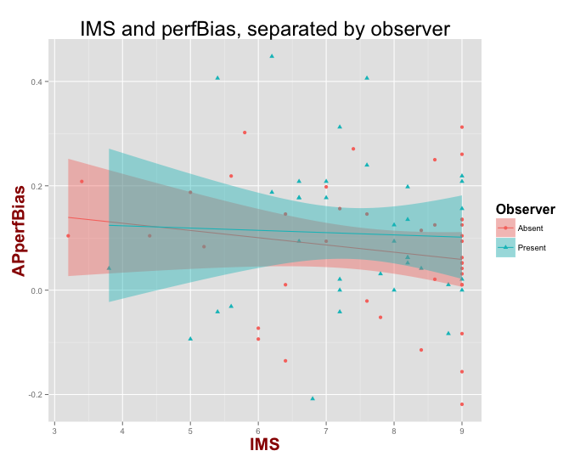
BAD SUBJECTS EXCLUDED (for both tasks)
Performance bias on IMS in AP, separated by observer
Coefficients:
Estimate Std. Error t value Pr(>|t|)
(Intercept) 0.183828 0.098880 1.859 0.067 .
IMS -0.013885 0.012729 -1.091 0.279
ObserverPresent -0.043008 0.166092 -0.259 0.796
IMS:ObserverPresent 0.009521 0.021928 0.434 0.665
Residual standard error: 0.1365 on 74 degrees of freedom
(12 observations deleted due to missingness)
Multiple R-squared: 0.02886, Adjusted R-squared: -0.01051
F-statistic: 0.7331 on 3 and 74 DF, p-value: 0.5355

Slide 17
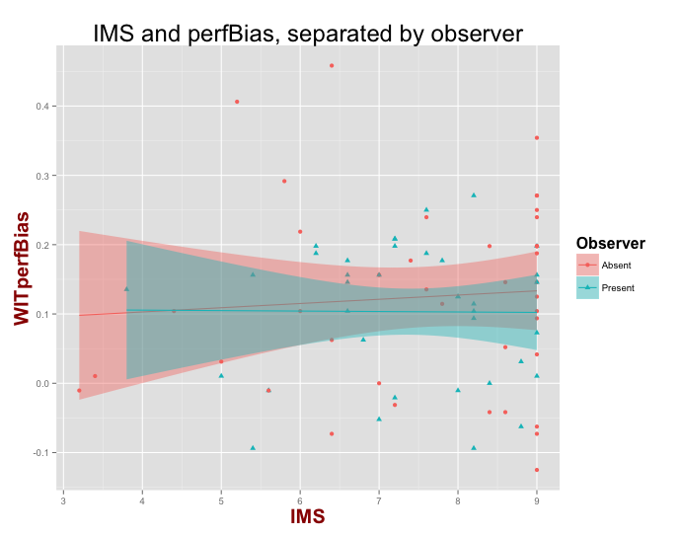
BAD SUBJECTS EXCLUDED (for both tasks)
Performance bias on IMS in WIT, separated by observer
Coefficients:
Estimate Std. Error t value Pr(>|t|)
(Intercept) 0.078581 0.087711 0.896 0.373
IMS 0.006086 0.011291 0.539 0.591
ObserverPresent 0.029597 0.147331 0.201 0.841
IMS:ObserverPresent -0.006745 0.019451 -0.347 0.730
Residual standard error: 0.1211 on 74 degrees of freedom
(12 observations deleted due to missingness)
Multiple R-squared: 0.01203, Adjusted R-squared: -0.02802
F-statistic: 0.3004 on 3 and 74 DF, p-value: 0.825

Slide 18
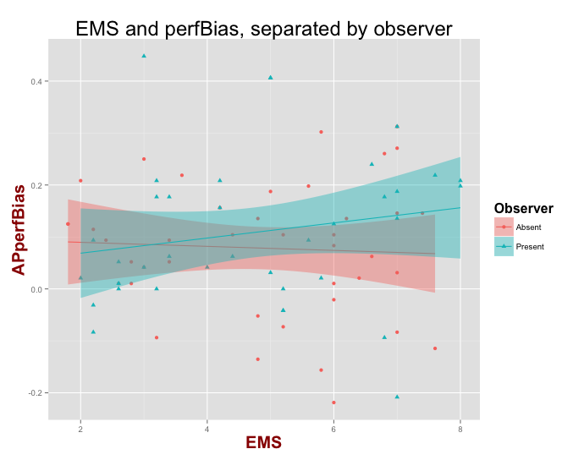
BAD SUBJECTS EXCLUDED (for both tasks)
Performance bias on EMS in AP, separated by observer
Coefficients:
Estimate Std. Error t value Pr(>|t|)
(Intercept) 0.097440 0.062652 1.555 0.124
EMS -0.003889 0.012105 -0.321 0.749
ObserverPresent -0.057886 0.088159 -0.657 0.513
EMS:ObserverPresent 0.018469 0.017186 1.075 0.286
Residual standard error: 0.1362 on 74 degrees of freedom
(12 observations deleted due to missingness)
Multiple R-squared: 0.03249, Adjusted R-squared: -0.006737
F-statistic: 0.8283 on 3 and 74 DF, p-value: 0.4825

Slide 19
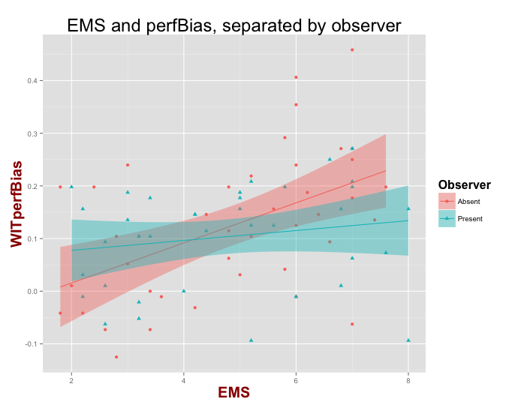
BAD SUBJECTS EXCLUDED (for both tasks)
Performance bias on EMS in WIT, separated by observer
Coefficients:
Estimate Std. Error t value Pr(>|t|)
(Intercept) -0.060532 0.050561 -1.197 0.235043
EMS 0.038058 0.009768 3.896 0.000213 ***
ObserverPresent 0.119181 0.071145 1.675 0.098119 .
EMS:ObserverPresent -0.028634 0.013869 -2.065 0.042468 *
Residual standard error: 0.11 on 74 degrees of freedom
(12 observations deleted due to missingness)
Multiple R-squared: 0.1853, Adjusted R-squared: 0.1523
F-statistic: 5.611 on 3 and 74 DF, p-value: 0.001602

Slide 20
Black_A, Black_C is DV
In PDPanalyses2.R

Slide 21
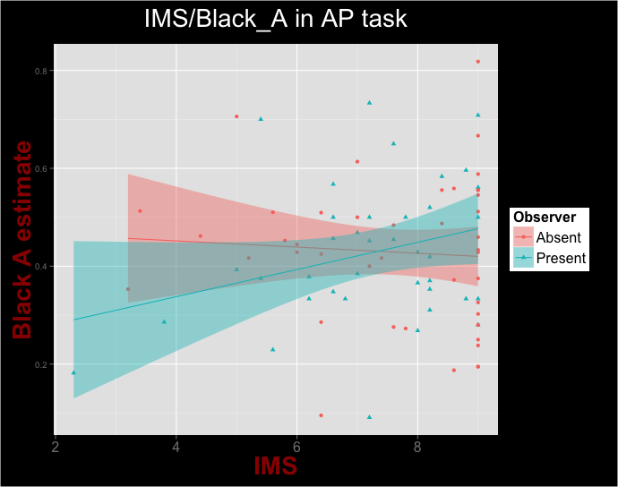
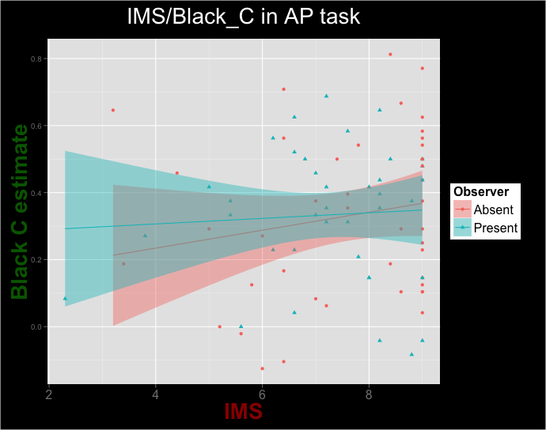
BAD SUBJECTS EXCLUDED (just for relevant task)
IMS predicting Black_A/Black_C in AP, separated by observer
Coefficients:
Estimate Std. Error t value Pr(>|t|)
(Intercept) 7.9316 0.7429 10.677 <2e-16 ***
Black_A -0.7947 1.6369 -0.485 0.629
ObserverPresent -1.9739 1.1011 -1.793 0.077 .
Black_A:ObserverPresent 3.7802 2.4351 1.552 0.125
Residual standard error: 1.589 on 77 degrees of freedom
(12 observations deleted due to missingness)
Multiple R-squared: 0.04931, Adjusted R-squared: 0.01227
F-statistic: 1.331 on 3 and 77 DF, p-value: 0.2704

Slide 22
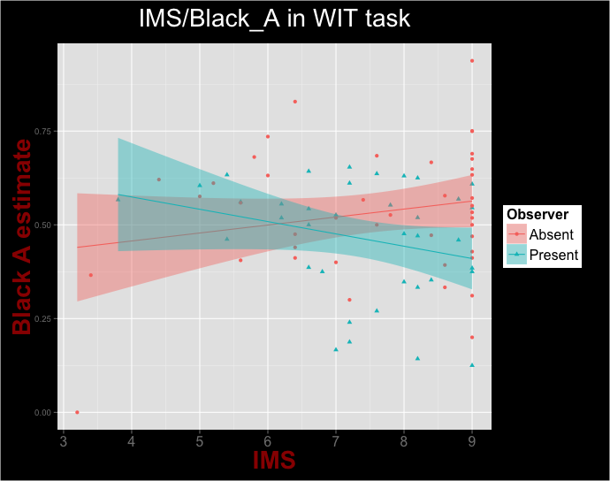
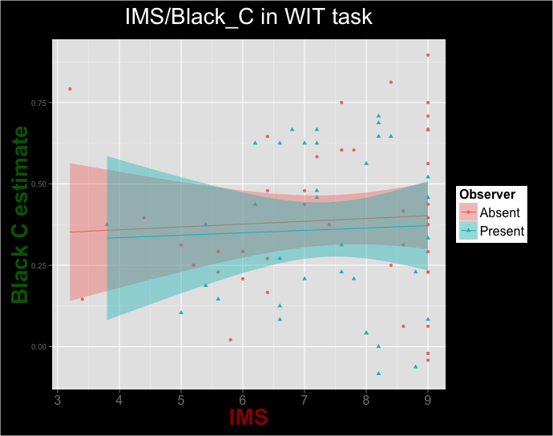
BAD SUBJECTS EXCLUDED (just for relevant task)
IMS predicting Black_A/Black_C in WIT, separated by observer
Coefficients:
Estimate Std. Error t value Pr(>|t|)
(Intercept) 6.4082 0.7498 8.546 9.88e-13 ***
Black_A 2.0757 1.3441 1.544 0.1267
ObserverPresent 1.9998 1.0868 1.840 0.0697 .
Black_A:ObserverPresent -4.3192 2.0988 -2.058 0.0430 *
Residual standard error: 1.491 on 76 degrees of freedom
(12 observations deleted due to missingness)
Multiple R-squared: 0.05599, Adjusted R-squared: 0.01873
F-statistic: 1.503 on 3 and 76 DF, p-value: 0.2207

Slide 23
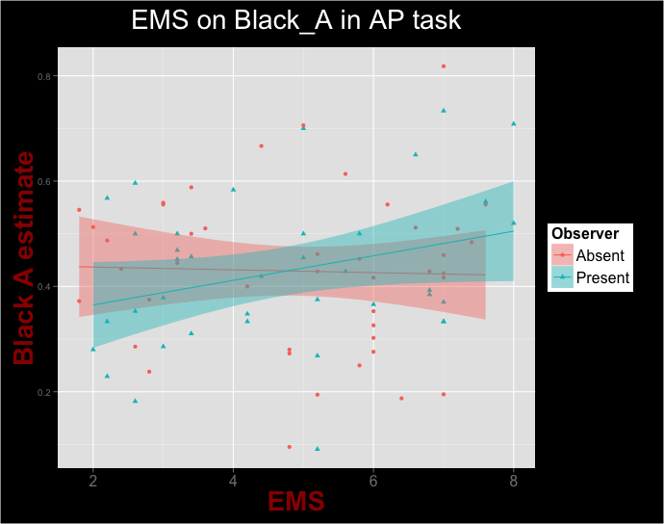
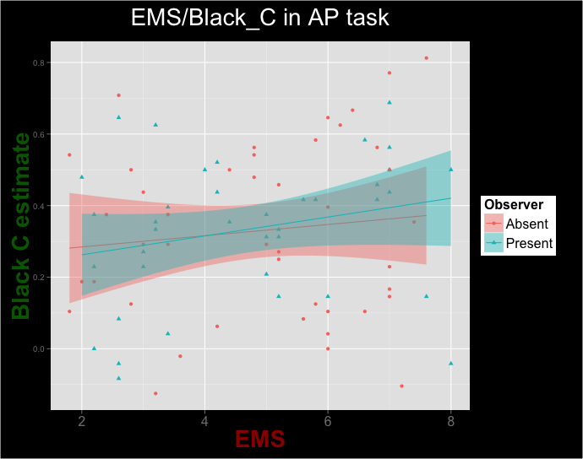
BAD SUBJECTS EXCLUDED (just for relevant task)
EMS predicting Black_A/Black_C in AP, separated by observer
Coefficients:
Estimate Std. Error t value Pr(>|t|)
(Intercept) 5.0902 0.8416 6.048 4.93e-08 ***
Black_A -0.3728 1.8544 -0.201 0.841
ObserverPresent -2.0657 1.2474 -1.656 0.102
Black_A:ObserverPresent 4.2548 2.7588 1.542 0.127
Residual standard error: 1.8 on 77 degrees of freedom
(12 observations deleted due to missingness)
Multiple R-squared: 0.04973, Adjusted R-squared: 0.01271
F-statistic: 1.343 on 3 and 77 DF, p-value: 0.2666

Slide 24
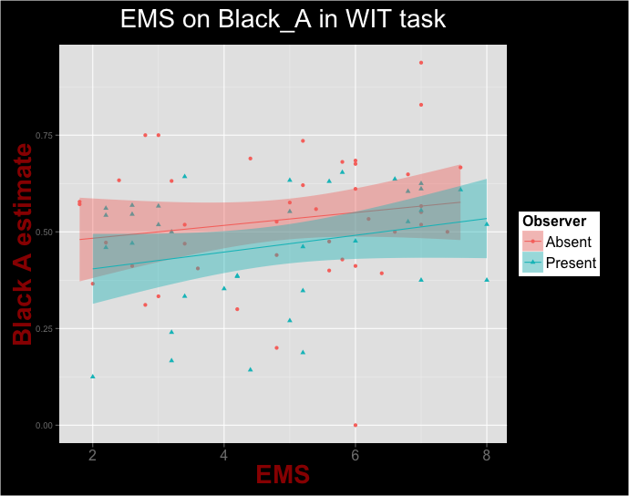
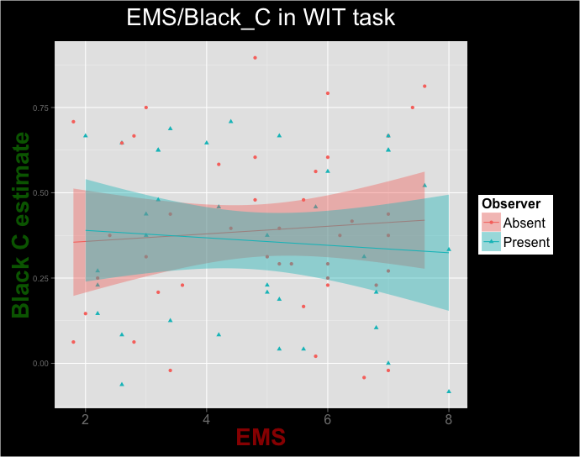
BAD SUBJECTS EXCLUDED (just for relevant task)
IMS predicting Black_A/Black_C in WIT, separated by observer

Slide 25
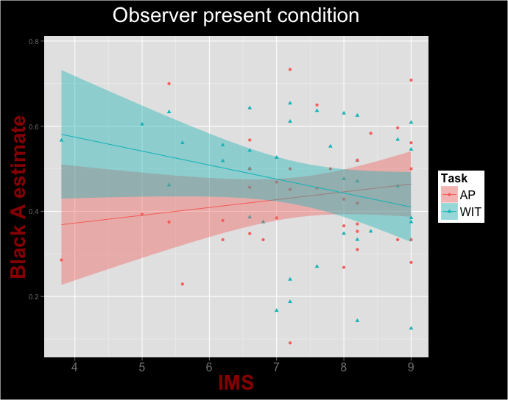
BAD SUBJECTS EXCLUDED (just for relevant task)
IMS predicting Black_A/Black_C in in both tasks, just in observer present condition
Coefficients:
Estimate Std. Error t value Pr(>|t|)
(Intercept) 0.29894 0.14250 2.098 0.0395 *
IMS 0.01836 0.01907 0.963 0.3390
TaskWIT 0.40676 0.20153 2.018 0.0474 *
IMS:TaskWIT -0.05120 0.02696 -1.899 0.0617 .
Residual standard error: 0.1458 on 70 degrees of freedom
(16 observations deleted due to missingness)
Multiple R-squared: 0.06235, Adjusted R-squared: 0.02216
F-statistic: 1.551 on 3 and 70 DF, p-value: 0.2089
Notes:
Analyses run as regression (Task isn’t specified as within subjects):
lm(value ~ IMS*Task, data = dat)
dat = longDat[longDat$Observer == "Present" & longDat$Estimate == "Black_A",]

